Slide 1
TennisScale
The fun way to measure height

Slide 2
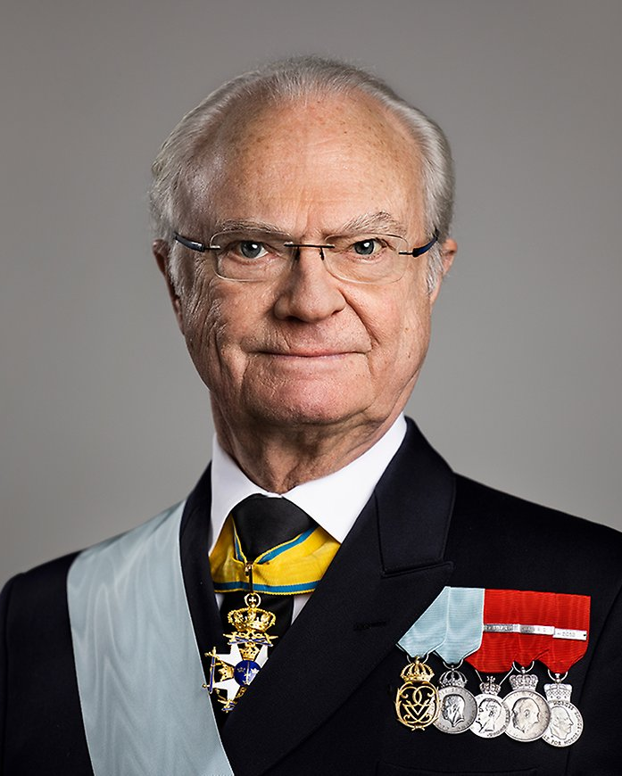

The client: VertiScan AI
CEO: Magnus Höjd
Founded in 2023 by Magnus Höjd, VertiScan AI is a Swedish tech gem hailing from the innovation hub of Stockholm. With a playful nod to their heritage, the name Höjd translates to "height," reflecting the company's focus on cutting-edge AI solutions for vertical measurements.
Under the leadership of CEO Magnus Höjd, VertiScan AI has quickly risen to new heights, offering state-of-the-art tools for industries like construction, real estate, and forestry. Their flagship product, the VertiScan AI Platform, combines advanced AI algorithms with Swedish precision to deliver unmatched accuracy and user-friendliness.

Slide 3

Mission Statement
Helping Swedes measure heights.

Slide 4

Problem
In Sweden, people do not want to measure using traditional boring methods, thus ball dropping is the only solution.

Slide 5
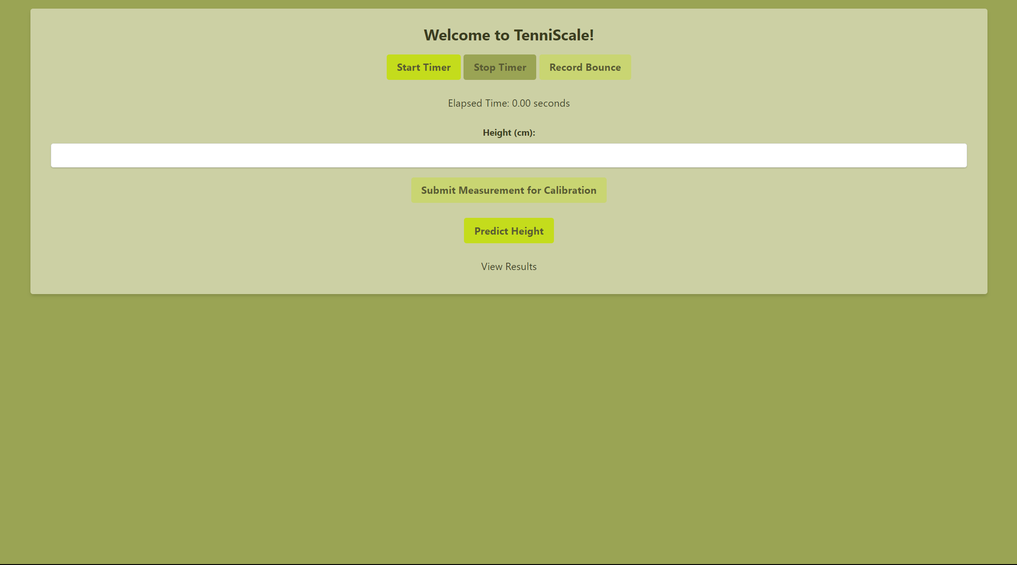

Slide 6


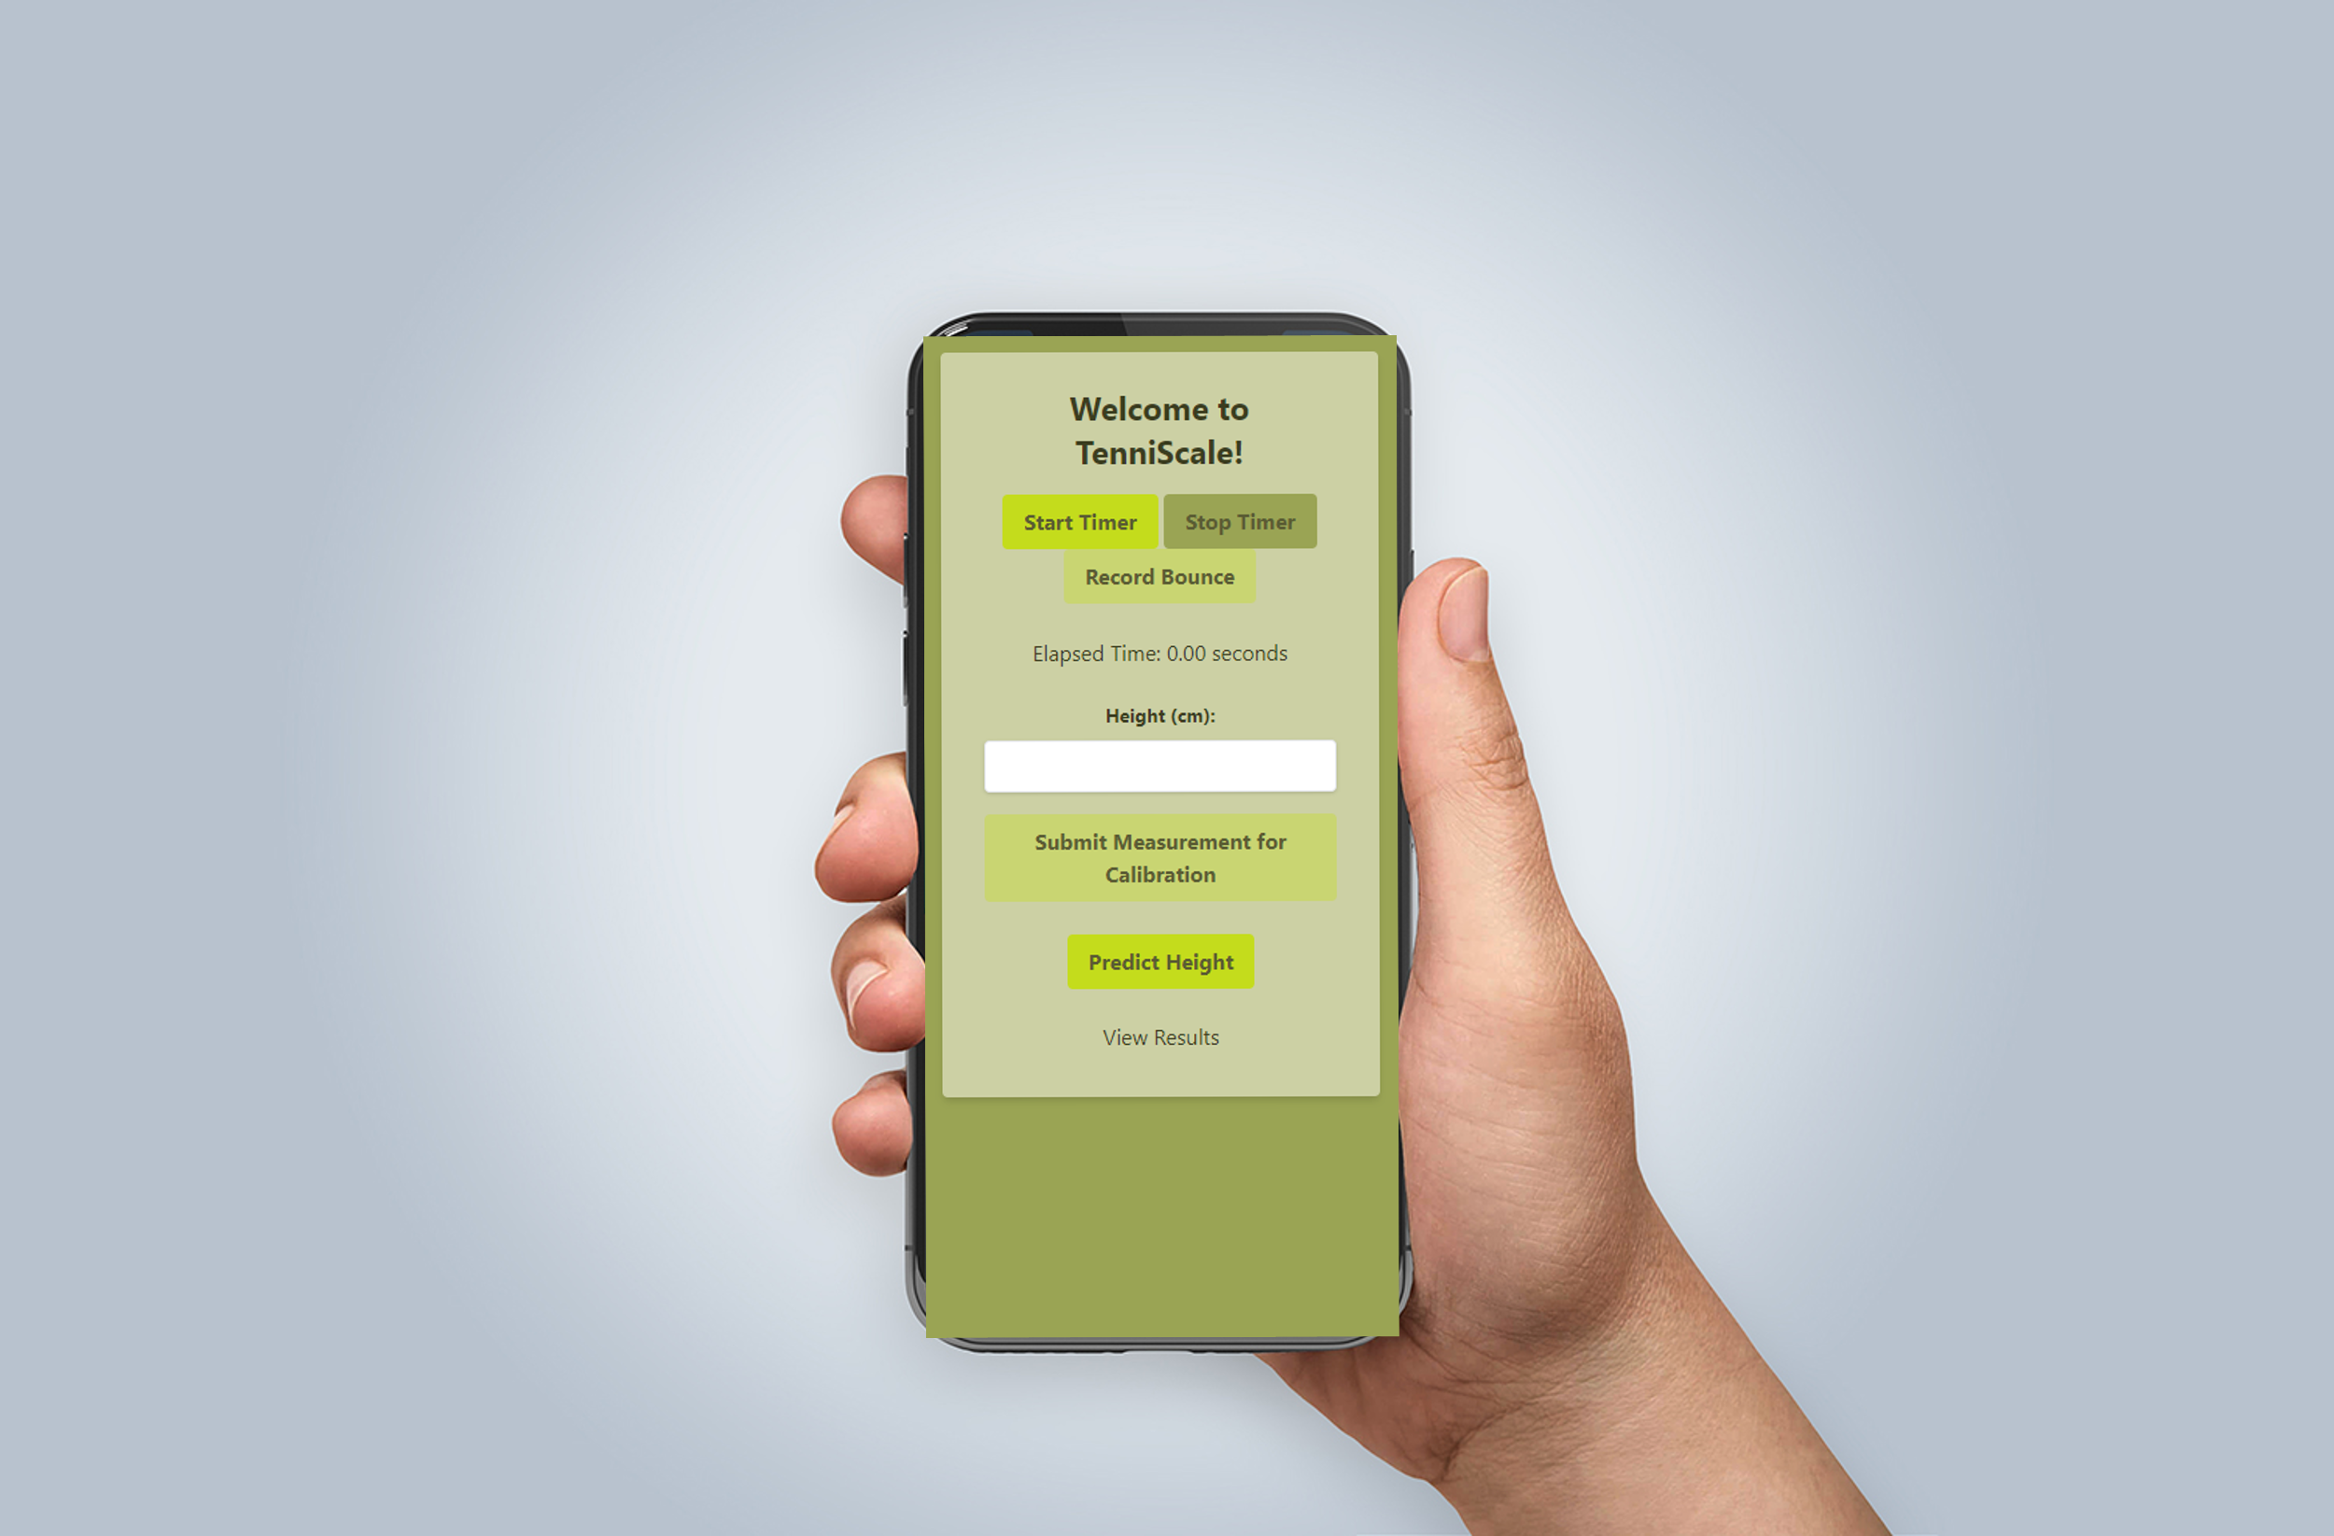
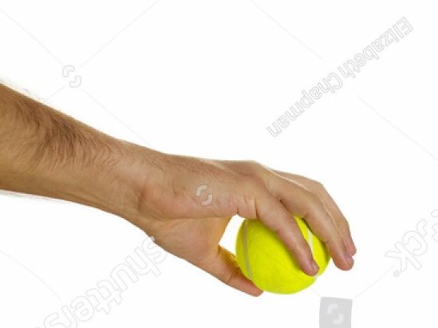

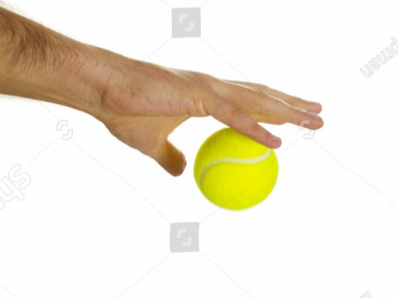
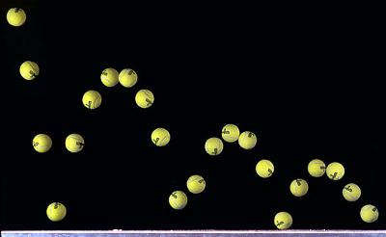
Usage
Notes:
Its very simple
Start by holding the ball
Release the ball and click record
On everybounce click record bounce.
when you done click stop recording

Slide 7

Requirements
An arm
Head size
2 arms
Notes:
You need an arm. Not the most accessable
You need around the same size as me
2 arms one for the ball, one for the software

Slide 8




Why us?
Easy to use
Always uses the best model
Any device
Gets better with usage
Notes:
Performs better with usage

Slide 10
The Best We Can Be

